Slide 1
VLSI Test Principles and Architectures
Chapter 7, Logic Diagnosis
Haochen Ding

Slide 2
INTRODUCTION
00

Slide 3
00 Introduction
Logic Diagnosis
Definition: to compare the behaviour of a fault-free model (which is a gate-level circuit or a transistor schematic) with a failing chip.
Circuit under diagnosis (CUD): the fault-free circuit to be compared with
Output pair: (z1, z2) is called an output pair if z1 and z2 are corresponding outputs from the CUD and the failing chip, respectively
Failing test vector: A test vector v is called a failing test vector if it creates a mismatch at any output pair
Metrics:
Diagnostic resolution: the total number of defect candidates reported
First-hit index: the index of the first candidate in the ranked list that turns out to be a true defect site
Top-10 hit: the number of defects hit by the top-10 candidate
Success rate: the percentage of hitting at least one defect in one chip inspection session

Slide 4
00 Introduction – Contents of This Chapter
01 Combinational Logic Diagnosis
02 Scan Chain Diagnosis
03 Logic BIST Diagnosis

Slide 5
Combinational Logic Diagnosis
01

Slide 6
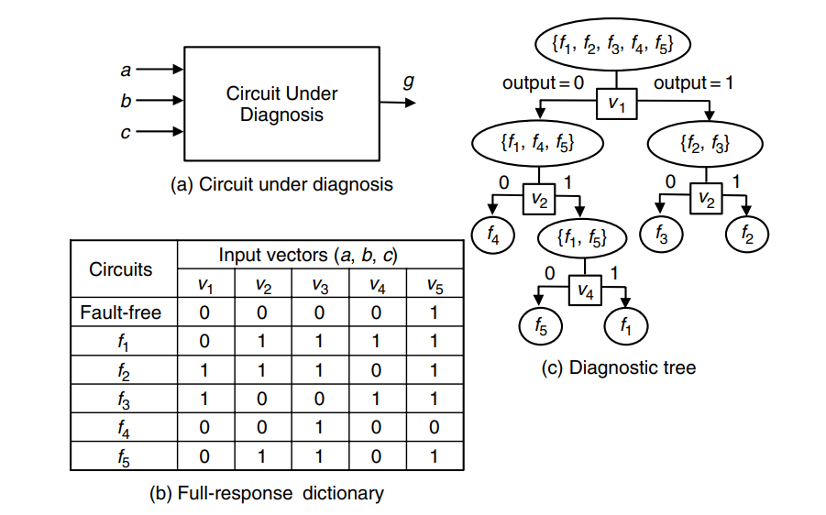
01 Combinational Logic Diagnosis – Cause-Effect Analysis
Combinational Logic Diagnosis – Cause-Effect Analysis
Confine the causes of failure to a specific fault type.
Perform intensive fault simulation to build a fault dictionary (such as dictionary trees).
Use table look-up to analyse the effect or syndrome of the failing chip.
Problems:
Dictionary size
Fault unmodeled

Slide 7
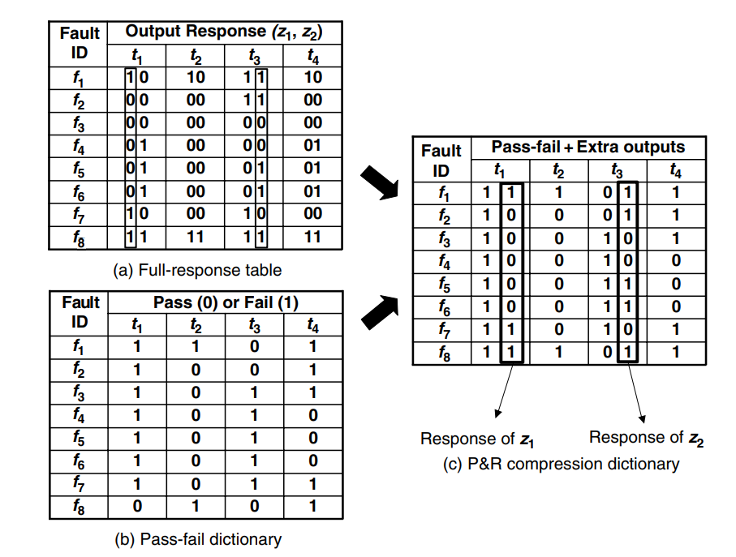
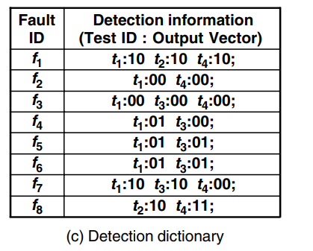
01 Combinational Logic Diagnosis – Cause-Effect Analysis
Combinational Logic Diagnosis – Cause-Effect Analysis
Compression and Compaction on Dictionary
Pass-Fail dictionary: replace an output response vector by a single pass-or-fail bit
It leads to a high compaction ratio
It may become infeasible to locate the root causes of failure
Pomeranz-Reddy dictionary: selectively putting back a sufficient amount of output response information to restore the full diagnostic resolution. It is a compression rather than a compaction.
Detection dictionary: record only the failing output vectors
The structure becomes irregular.

Slide 8
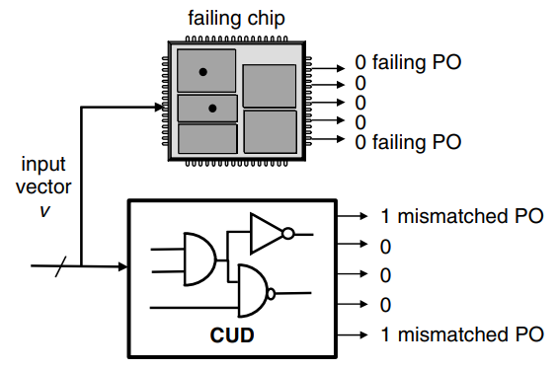
01 Combinational Logic Diagnosis – Effect-Cause Analysis
Combinational Logic Diagnosis – Effect-Cause Analysis
Advantages:
It is more suitable to handle non-stuck-at faults.
It can be adapted to cases where there are multiple faults in the failing chip, especially when these faults are structurally codependent.
It can be adapted to partial-scan designs more easily.
Disadvantage: it takes a little longer time to contemplate.
Mismatch:
the CUD output is called mismatched output
the chip’s output is called failing output

Slide 9
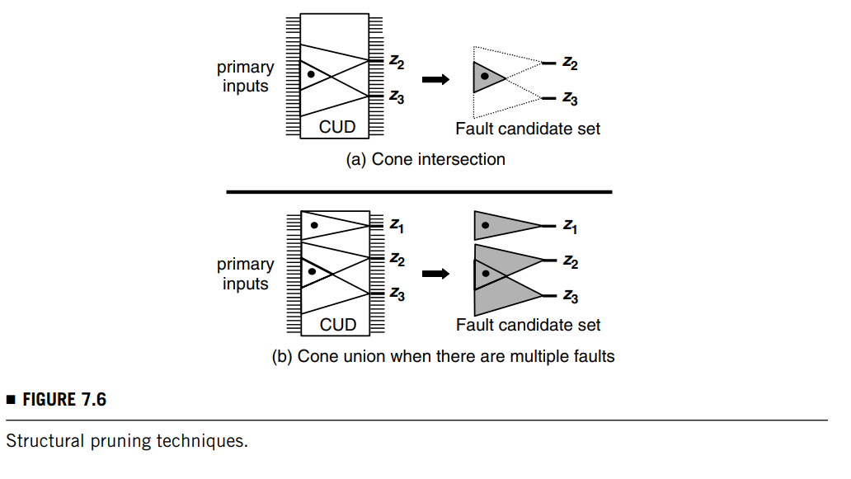
01 Combinational Logic Diagnosis – Effect-Cause Analysis
Combinational Logic Diagnosis – Effect-Cause Analysis
Structural Pruning:
If there is only one fault, then we take the intersection of the fan-in cones of the mismatched outputs.
If there is more than one fault in the failing chip, then we should perform cone union instead.
Advantages:
Cone intersection is much more effective.
Cone union is safer and more conservative.

Slide 10
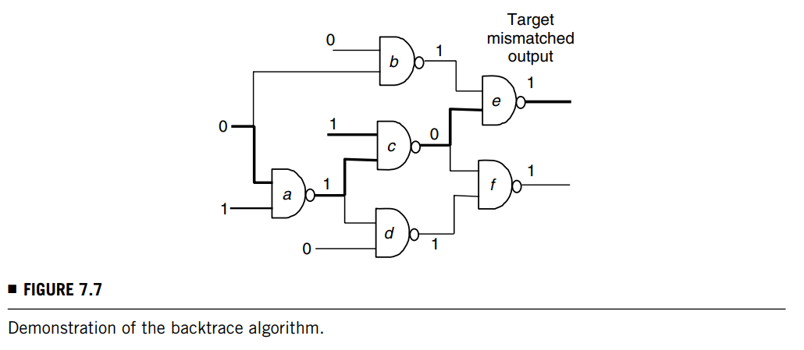
01 Combinational Logic Diagnosis – Effect-Cause Analysis
Combinational Logic Diagnosis – Effect-Cause Analysis
Backtrace Algorithm:
From each mismatched output, it traces the CUD backward to find the signals that can account for the output mismatch.
Rules:
Controlling rule: Only fan-in signals of g with controlling values (i.e., 0) are considered responsible.
Non-controlling rule: the current value of signal g is determined by all fan-in signals; therefore, every fan-in signal is held responsible.

Slide 11
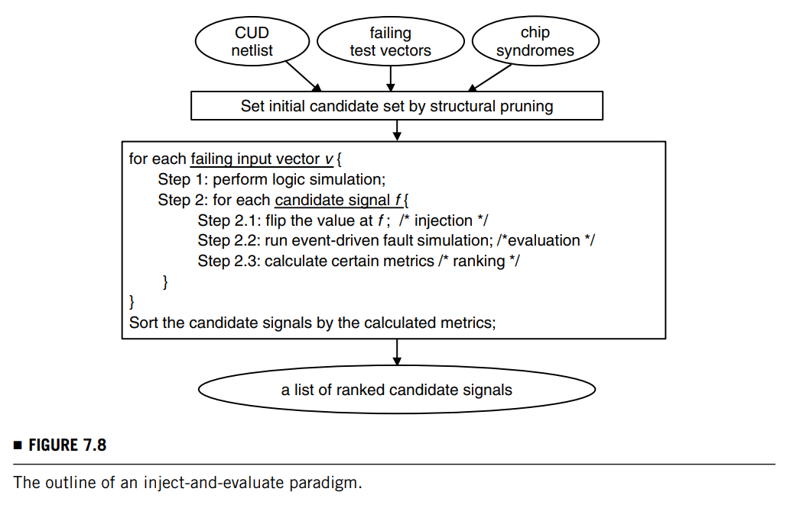
01 Combinational Logic Diagnosis – Effect-Cause Analysis
Combinational Logic Diagnosis – Effect-Cause Analysis
Inject-and-Evaluate Paradigm
It performs the diagnosis by a sequence of fault injections and evaluations.
Reproduction Principle: find a spot for injection and then reproduce the syndrome.
For a failing chip with only one single fault, there always exists a signal in the CUD that can cure all failing test vectors.

Slide 12
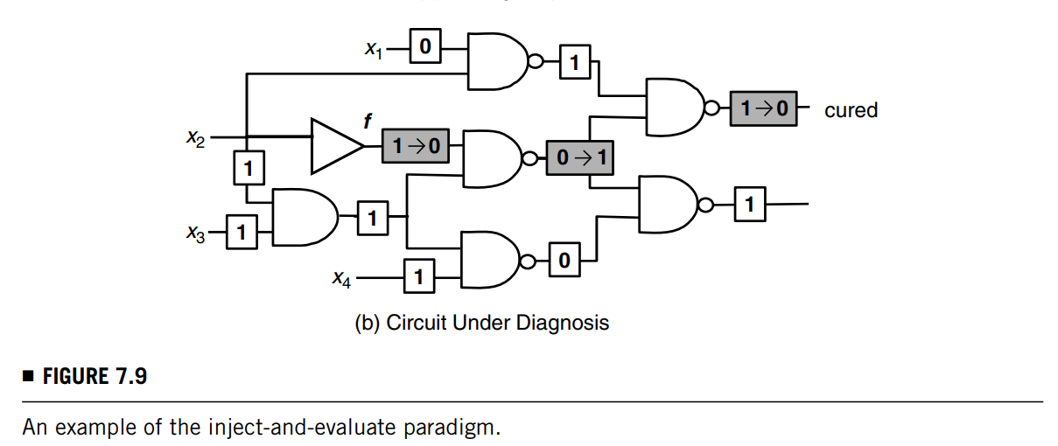
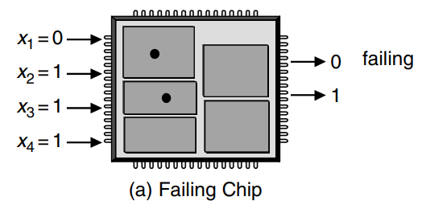
01 Combinational Logic Diagnosis – Effect-Cause Analysis
Combinational Logic Diagnosis – Effect-Cause Analysis
Inject-and-Evaluate Paradigm
Computational details:
Set the initial event queue to have only one signal-value pair, (f , fv), where f is a candidate signal under consideration and fv is the original fault-free value at this signal.
Perform an event-processing loop until there is no event left in the event queue.
Update the total number of curable outputs of the candidate signal under consideration.
Roll back the value of each signal of the CUD to its fault-free signal before moving on to the next candidate signal.

Slide 13
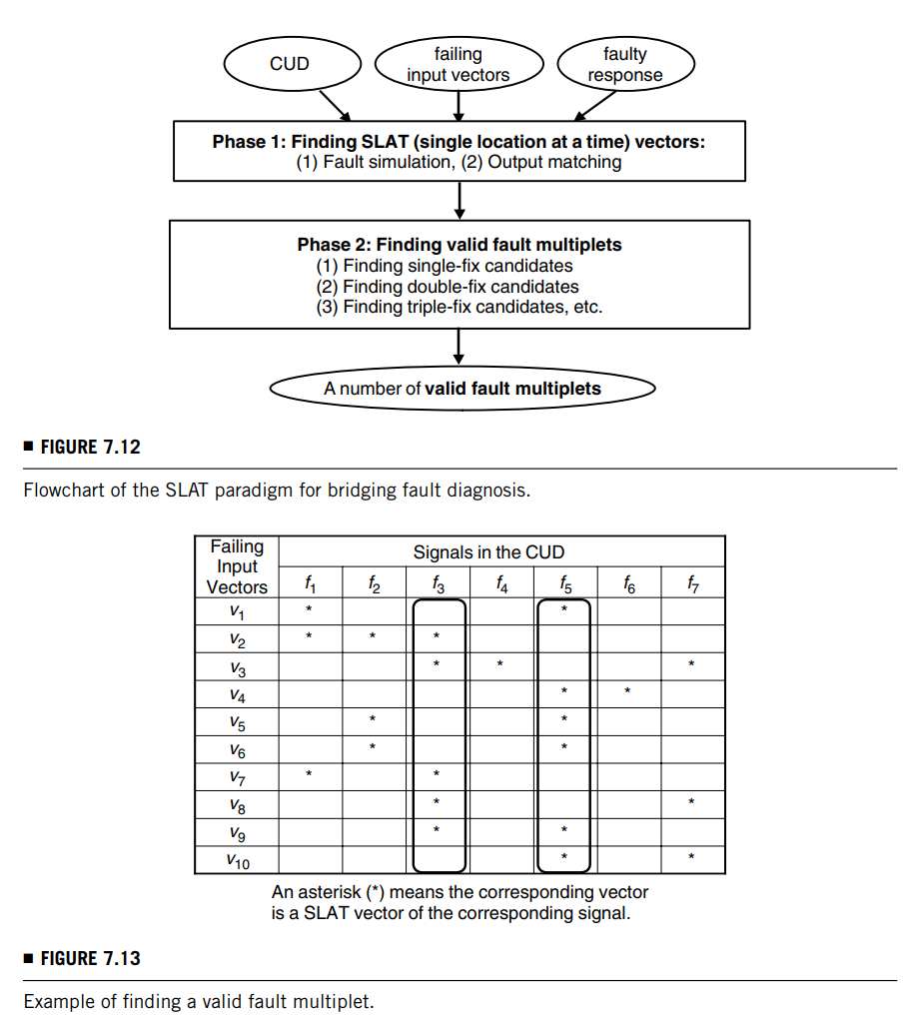
01 Combinational Logic Diagnosis – Effect-Cause Analysis
Combinational Logic Diagnosis – Effect-Cause Analysis
Inject-and-Evaluate Paradigm
Usage in bridging defect detections: one may wish to identify both affected cells instead of just one of them so as to pinpoint the exact location of the defect more accurately by analysing the layout.
SLAT (single location at a time) paradigm:
finding SLAT vectors: the paradigm uses a procedure similar to the aforementioned inject-and-evaluate paradigm to find out all possible curable vectors (called SLAT vectors here) for each signal. The results can be viewed as a two-dimensional table, which is referred to as SLAT table.
finding valid fault multiplets: this algorithm aims to find a set of signals, called a multiplet, so these signals can take turns explaining the failing syndrome of each failing input vector.

Slide 14
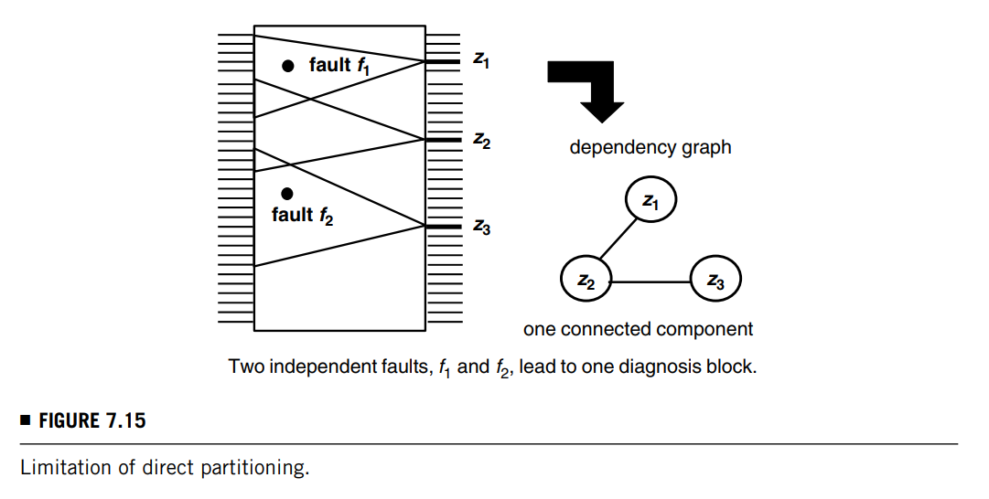
01 Combinational Logic Diagnosis – Chip-Level Strategy
Combinational Logic Diagnosis – Chip-Level Strategy
Direct Partitioning
Independent/dependent fault: whether the fanout cone of this fault does not overlap with that of any other fault.
Intuitively, an independent fault is easier to identify than a dependent fault.
Divide-and-Conquer Strategy
Dependency graph, with each node denoting a mismatched output and each edge (zi, zj) denoting the overlapping relationship between the fan-in cones of two mismatched outputs zi and zj.
In practice, such a direct partitioning may fail to isolate independent faults.
Let the reachable mismatched outputs of fault f1 be z1, fault f2 be z2 & z3.

Slide 15
01 Combinational Logic Diagnosis – Chip-Level Strategy
Combinational Logic Diagnosis – Chip-Level Strategy
Two-Phase Strategy
In the first phase, a concept called prime candidate is used.
Without performing partitioning, certain structurally independent faults can be identified precisely using this concept.
In the second phase, the syndromes (i.e., the mismatched outputs and their respective fanin cones) caused by the prime candidates are eliminated first.
Then, the dependency-graph-based partitioning becomes more effective and the faults can be targeted one by one through a number of block-level diagnosis runs.
Partially Curable: A failing test vector v is partially curable by a signal f if the mismatches at all mismatched outputs reachable by f can be resolved by an injection at signal f.
SIC (Structurally Independent Fault Candidate): A signal f is a SIC point if every failing test vector is a partially curable vector of signal f.
Observations: A signal at a structurally independent fault site is a SIC point, but a SIC point is not necessarily a structurally independent fault site.

Slide 16
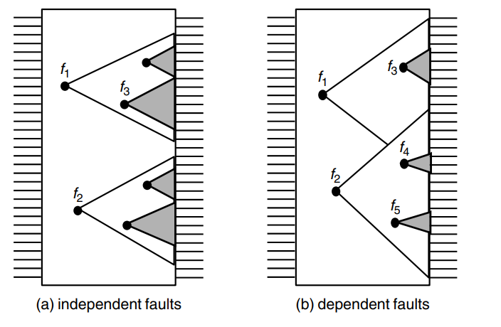
01 Combinational Logic Diagnosis – Chip-Level Strategy
Combinational Logic Diagnosis – Chip-Level Strategy
Two-Phase Strategy
Prime Candidate: A signal f is a prime candidate for a structurally independent fault if the following two conditions are satisfied:
Signal f is a SIC point
the set of outputs reachable by signal f is not a proper subset of that of any other SIC point
E.g. in the graph (a) only f1 and f2 can be considered as prime candidates.

Slide 17
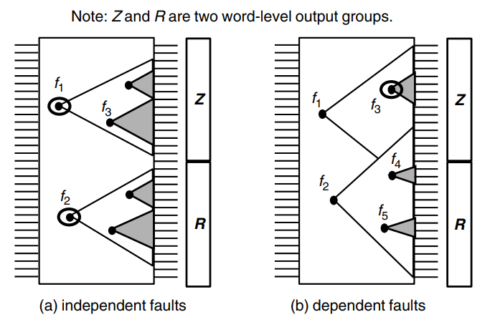
01 Combinational Logic Diagnosis – Chip-Level Strategy
Combinational Logic Diagnosis – Chip-Level Strategy
Two-Phase Strategy
Reachable Output Group: Let Z be an output group containing a number of outputs z1 z2 zk . Then Z is called a reachable output group of a signal f if there exists a path from f to an output in Z.
Word-Level Prime Candidate: A signal f is a word-level prime candidate if the following three conditions are satisfied:
Signal f is a SIC point
The set of reachable outputs of f is not a proper subset of that of any other SIC point
(Newly added) Every mismatched output in the reachable output groups of signal f is also reachable from signal f
E.g. in graph (b), only f3 (instead of f3/f4/f5) will survive as a word-level prime candidate
This filter is much stronger than prime candidate.

Slide 18
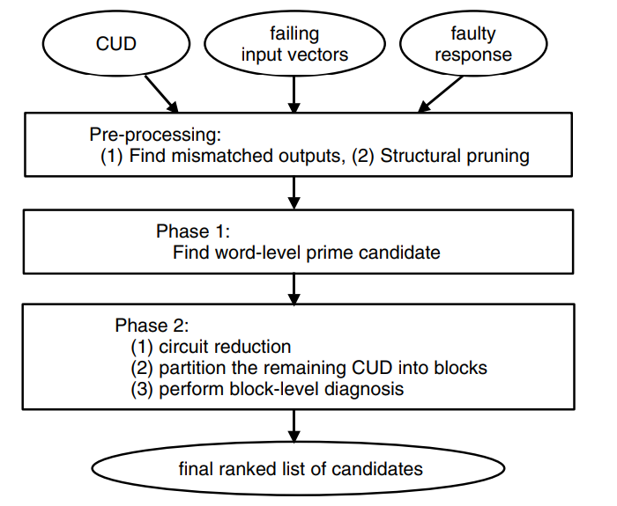
01 Combinational Logic Diagnosis – Chip-Level Strategy
Combinational Logic Diagnosis – Chip-Level Strategy
Overall Chip-Level Diagnostic Flow
First, we run fault-free simulation on the CUD using every failing test vector to determine the mismatched outputs.
Second, we adopt the common structural pruning techniques to narrow the fault candidate area down to the joint fan-in cones of the mismatched outputs.
In the first phase, fault simulation using each failing test vector is necessary in the identification process of the word-level prime candidates.
In the second phase, the CUD reduction is quickly carried out through simple structural analysis, then a dependency graph is incorporated to break down the remaining CUD to one or several diagnosis blocks.
Finally, one ranked list of candidates will be generated for each block.

Slide 19
Scan Chain Diagnosis
02

Slide 20
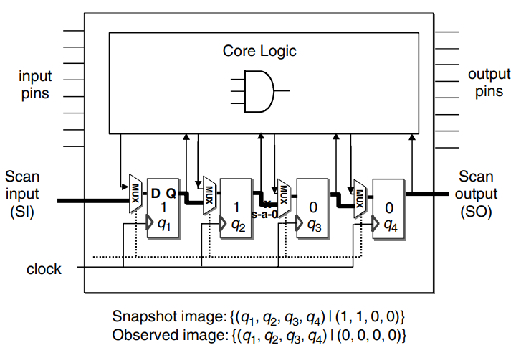
02 Scan Chain Diagnosis – Preliminaries for Scan Chain Diagnosis
Scan Chain Diagnosis – Preliminaries for Scan Chain Diagnosis
Snapshot Image: The snapshot image of a scan chain is the logic value combination of all the scanned flip-flops at a particular time instance.
The snapshot image at any clock cycle of the fault-free circuit under diagnosis is available through functional simulation as long as a test sequence is given
The snapshot images of a scan chain in a failing chip are obviously not available due to the blockage.
Observed Image: The observed image of a scan chain is the scanned-out version of a snapshot image.
For a fault-free circuit, it is equivalent to the snapshot image.
For a failing chip, it consists of the bitstream collected at the scan output pin.

Slide 21
02 Scan Chain Diagnosis – Preliminaries for Scan Chain Diagnosis
Scan Chain Diagnosis – Preliminaries for Scan Chain Diagnosis
Scan_Shift Command: A command that serially applies a bit into the scan chain through the scan input pin and retrieves a bit out of the scan chain from the scan output pin at the same time.
Capture Command: A functional-mode command that forces each flip-flop to take its functional input, instead of the scan input, as the content. A system clock (if different from the scan clock) might be needed.
Apply Command: The apply command is a functional-mode command that applies a vector to the chip input pins of the circuit under diagnosis.

Slide 22
02 Scan Chain Diagnosis – Preliminaries for Scan Chain Diagnosis
Scan Chain Diagnosis – Preliminaries for Scan Chain Diagnosis
Targeted Fault Categories include:
Functional or timing
For functional faults, stuck-at and bridging faults are mostly used, among which diagnosis of a bridging fault in the scan chain is usually more challenging due to its huge possible fault candidate space and its intermittent nature.
For timing faults, two types of timing violations associated with the flip-flops need to be considered: setup time violation and hold-time violation.
Permanent or intermittent
An intermittent fault refers to a fault that occurs non-deterministically or only under a certain operating environment (e.g., when the power supply is noisy or unstable).

Slide 23
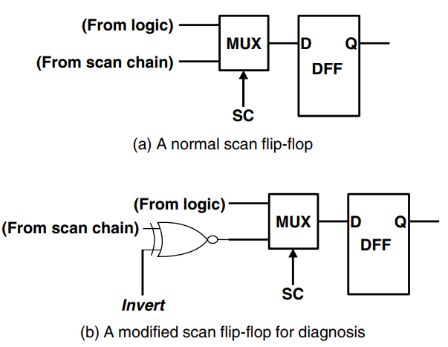
02 Scan Chain Diagnosis – Hardware-Assisted Method
Scan Chain Diagnosis: Hardware-Assisted Method
Basic idea: a scan chain is difficult to diagnose, so one may need to insert extra logic to facilitate the process.
Procedure:
Prepare a flush pattern (e.g., all-1 pattern).
Scan in this pattern into the scan chain.
If there are n flip-flops in the chain, we need to apply n scan-shifting commands.
Invert the scan chain by setting signal invert to one.
Scan the image out of the scan chain.
Check the observed image to see if there is a stuck-at-0 flip-flop in the scan chain.
Repeat all steps by flushing the all-0 pattern to see if there is a stuck-at-1 flip-flop.

Slide 24
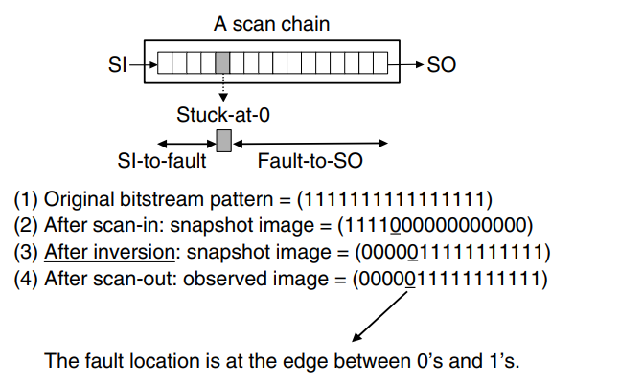
02 Scan Chain Diagnosis – Hardware-Assisted Method
Scan Chain Diagnosis: Hardware-Assisted Method
Example:
Assume that we have a stuck-at-0 fault at the fifth flip-flop
The snapshot image in the failing chip will become (1111000000000000)
Then we try to invert this snapshot image to (0000011111111111)
The fault location is revealed at the edge between the 0’s and 1’s

Slide 25
02 Scan Chain Diagnosis – Modified Inject-and-Evaluate Paradigm
Scan Chain Diagnosis: Modified Inject-and-Evaluate Paradigm
Procedure:
Run a flush test to guess the type of the faults.
Pick one scan vector as a bitstream. Simulate the scan–capture–scan process on the CUD to derive the fault-free (observed) image.
Pick one possible fault candidate. Inject the fault effect into the scan chain.
Simulate the scan–capture–scan process on the CUD and derive its failing (observed) image.
Compare the failing image with the fault-free image. Accumulate the matching score for each fault candidate.
Go back to step 3 if there are more candidates.
Go back to step 2 if there are more scan vectors.
Rank candidates based on their matching scores. The higher the score, the higher the rank.

Slide 26
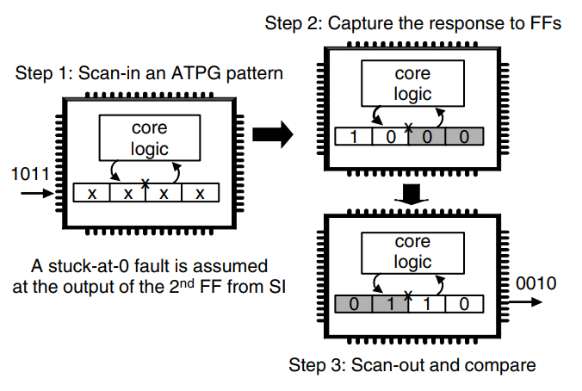
02 Scan Chain Diagnosis – Modified Inject-and-Evaluate Paradigm
Scan Chain Diagnosis: Modified Inject-and-Evaluate Paradigm
In general, this paradigm is not as effective as that of the combinational logic diagnosis, due to a number of reasons:
It is not easy to find a universal injection model to represent the fault effect of a scan chain fault.
A test session now takes multiple clock cycles to complete.
The distortion is so severe that many faults could have similar effects on the final observed image.

Slide 27
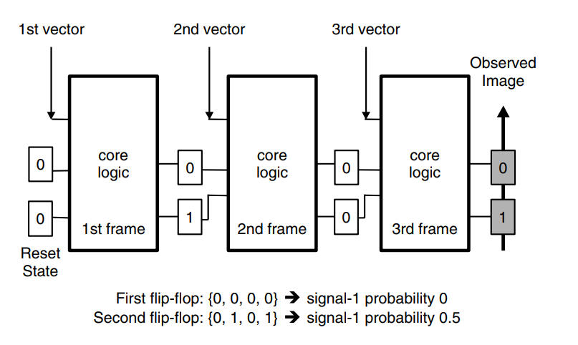
02 Scan Chain Diagnosis – Signal-Profiling-Based Method
Scan Chain Diagnosis: Signal-Profiling-Based Method
Diagnostic Test Sequence: literally the functional sequence derived from the simulation testbench, which could start from a given reset state or an unknown state.
The primary objective for such a sequence is to bring the failing chip through a state sequence as randomly as possible.
The test sequence selection is first done by selecting a number of clock cycles, with an attempt to make the values of each flip-flop at these selected clock cycles as random as possible.

Slide 28
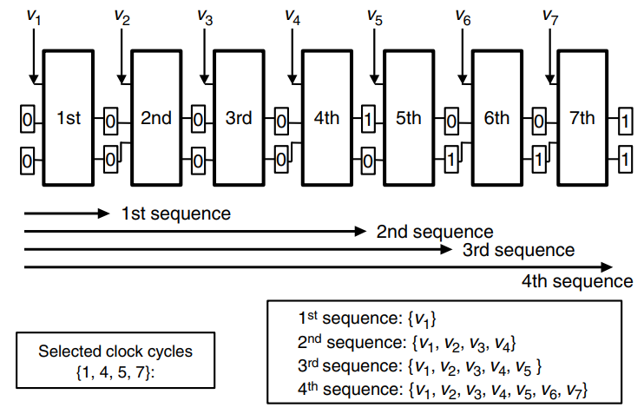
02 Scan Chain Diagnosis – Signal-Profiling-Based Method
Scan Chain Diagnosis: Signal-Profiling-Based Method
Run-and-Scan Test Application: the procedure involves running a number of functional sequences followed by a number of scan-out operations.
At the end of each test sequence application, only the final snapshot image of the scan chain is shifted out and recorded as the observed images.
A large number of test sequences are required to achieve accurate diagnosis results.
For each selected clock cycle j, we simply take the prefix of the functional sequence up to this clock cycle as the corresponding sequence, such as v1, v2, …, vj.

Slide 29
02 Scan Chain Diagnosis – Signal-Profiling-Based Method
Scan Chain Diagnosis: Signal-Profiling-Based Method
Why Functional Sequences?
There are two stages during the run-and-scan test application:
Functional sequence stage: the snapshot image of the scan chain inside the failing chip is only slightly affected by the fault.
Scan-shifting stage: the fault effect is much more prominent during the scan-shifting stage, when a snapshot image is shifted out to become the failing observed image. The distortion at this stage is usually dramatically biased.

Slide 30
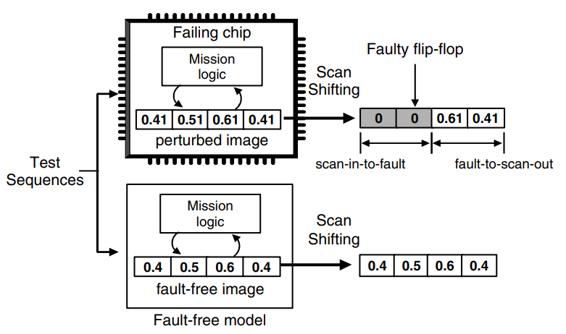
02 Scan Chain Diagnosis – Signal-Profiling-Based Method
Scan Chain Diagnosis: Signal-Profiling-Based Method
Why Functional Sequences?
An image can be viewed as the composition of two parts, the SI-to-fault part and the fault-to-SO part.
When shifting out a snapshot image, the fault-to-SO part is not affected, while the SI-to-fault part could be seriously distorted.
As a result, it is very likely that there will be a big difference between the failing image and fault-free image for the SI-to-fault part but not for the fault-to-SO part.

Slide 31
02 Scan Chain Diagnosis – Signal-Profiling-Based Method
Scan Chain Diagnosis: Signal-Profiling-Based Method
Why Functional Sequences?
This approach could be relatively robust even when there are also certain faults in the combinational logic.
Such fault is likely to cause white-noise type of fault effects on the flip-flops; therefore, the biased fault effects during the scan shifting stage can still dominate the overall failing syndrome at the chip’s output and thereby provide diagnosis information.
It is also applicable to designs without a completely known reset state.
In that case, we can resort to the three-valued logic simulation in deriving the diagnostic test sequences and the snapshot images.

Slide 32
02 Scan Chain Diagnosis – Signal-Profiling-Based Method
Scan Chain Diagnosis: Signal-Profiling-Based Method
Profiling-Based Analysis
Profile the signal-1 frequency of each flip-flop bit from the fault-free observed images.
The result is a fault-free profile, denoted as good-i, where i is the flip-flop index.
Profile the signal-1 frequency of each flip-flop bit from the set of failing observed images.
The result is a failing profile, denoted as bad-i.
Compute the difference profile between the fault-free images and the failing images.
For a flip-flop q-i, we calculate the frequency that its fault-free value is different from its failing value as the difference frequency.
Once the difference frequency has been derived for each flip-flop, we can derive the profile over the entire scan chain to analyse the trend for revealing the fault location.
Perform filtering on the difference profile to eliminate the glitches.
Perform edge detection to derive a suspicion profile.
In this profile, the flip-flops with higher suspicion values are considered more likely to be a fault location.

Slide 33
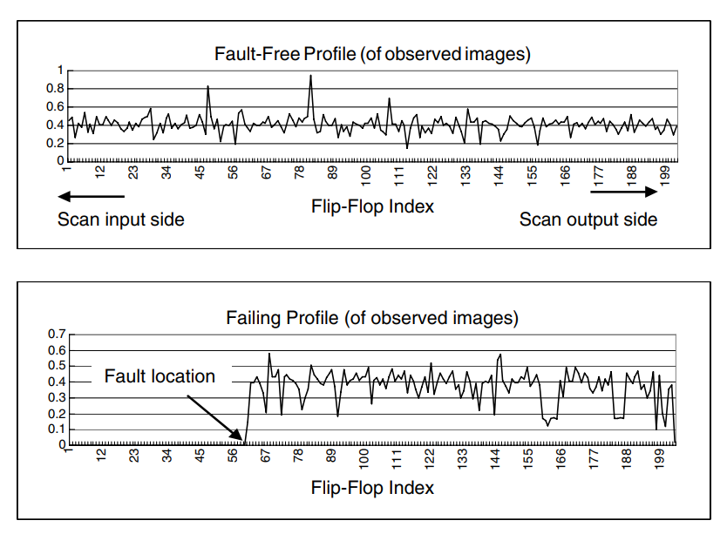
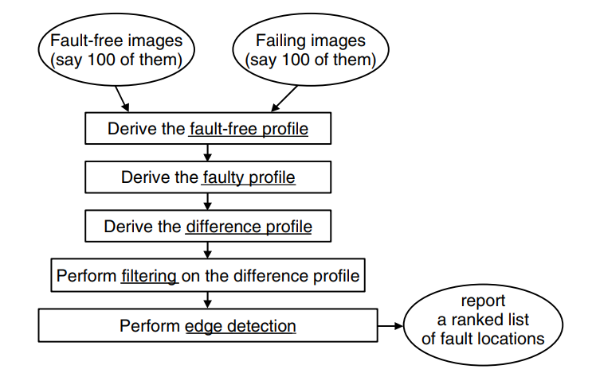
02 Scan Chain Diagnosis – Signal-Profiling-Based Method
Scan Chain Diagnosis: Signal-Profiling-Based Method
Profiling-Based Analysis

Slide 34
02 Scan Chain Diagnosis – Signal-Profiling-Based Method
Scan Chain Diagnosis: Signal-Profiling-Based Method
Average Sum Filtering: Assume that the difference profile is given and denoted as D[i], where i is the index of a flip-flop. We use the following formula to compute a smoothed difference profile, SD[i]: SD[i] = 0.2∗ D[i−2]+D[i−1]+D[i]+D[i+1]+D[i+2]
Edge Detection: suspicion[i] = SD[i-3]+SD[i-2]+SD[i-1]-SD[i+3]- SD[i+2]- SD[i+1].

Slide 35
02 Scan Chain Diagnosis – Signal-Profiling-Based Method
Scan Chain Diagnosis: Signal-Profiling-Based Method
The calculation is on the reward-and-penalty basis:
We add points to the overall score of a flip-flop i if its right-hand-side neighbours’ values are lower than the current SD[i]. This is a reward mechanism.
We deduct points from the overall score of a flip-flop i if its left-hand-side neighbours’ values deviate from the current SD[i]. This is a penalty mechanism.
The final suspicion degrees of the flip-flops are then sorted in a decreasing order as the final ranked list of fault candidates.

Slide 36
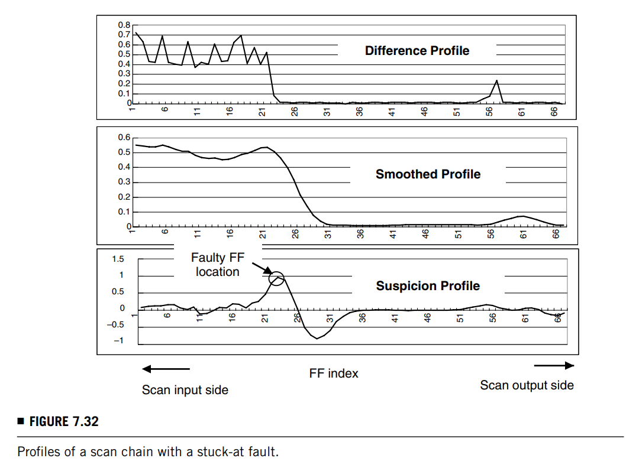
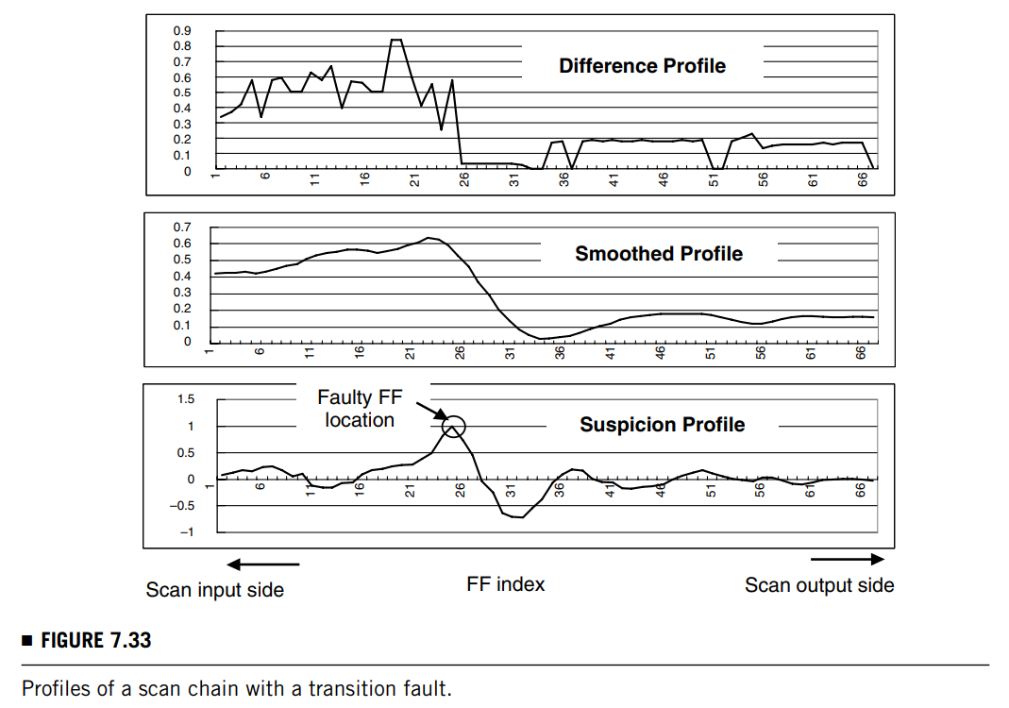
02 Scan Chain Diagnosis – Signal-Profiling-Based Method
Scan Chain Diagnosis: Signal-Profiling-Based Method

Slide 37
Logic BIST Diagnosis
03

Slide 38
03 Logic BIST Diagnosis
Logic BIST Diagnosis
Diagnosis in a BIST environment adds an extra level of difficulty compared with diagnosis in a non-BIST environment because it requires determining from compacted output responses which test vectors have produced a faulty response (time information) or which scan cells have captured errors (space information).
One simple but highly inefficient way to perform BIST diagnosis is to just bypass the MISR and shift out the full output response for every test vector to an external tester.
The problem with this approach is that typically a very large number of test patterns are applied to the circuit during BIST (orders of magnitude more than are applied in conventional deterministic testing); consequently, the tester may not have sufficient memory to store the full output response data for every vector.
Moreover, the time required for collecting and processing all of this data is generally not as cost effective as other more efficient BIST diagnosis approaches that are described in the remainder of this section.

Slide 39
03 Logic BIST Diagnosis – Interval-Based Methods
Logic BIST Diagnosis: Interval-Based Methods
Instead of running the entire BIST session to generate a single signature, the BIST is run in shorter intervals and generate a signature for each interval. It involves performing a binary search using intervals.
Procedure:
Load the PRPG with the normal initial seed, but load the pattern counter with only half the normal BIST length.
This specifies an interval equal to the first half of the normal BIST session.
Run the BIST for the specified interval.
When the BIST is complete, see if the signature is correct.
If the signature is faulty, then the first failing vector exists in the first half of the test vectors in the previous interval.
Step 2 is then repeated using the same initial seed as previously but only half the previous length.
This specifies a new interval equal to the first half of the previous interval.
If the signature is correct, then the first failing vector exists in the second half of the test vectors in the previous interval.
Step 2 is then repeated using a seed that corresponds to the start of the second half of the patterns in the previous interval, and only half the previous length is used.
This specifies a new interval equal to the second half of the previous interval.
The above procedure iterates until the interval becomes equal to only a single pattern (i.e., the interval length is equal to 1). At this point, the first failing pattern has been identified.

Slide 40
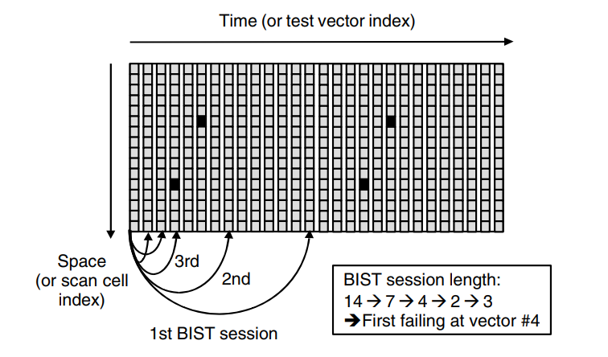
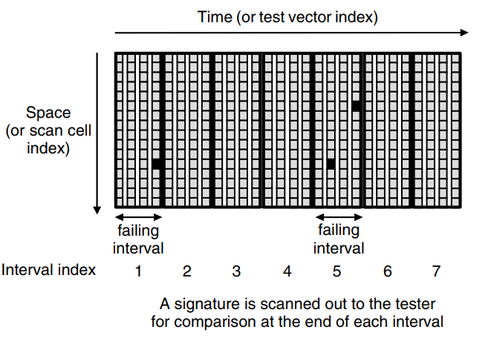
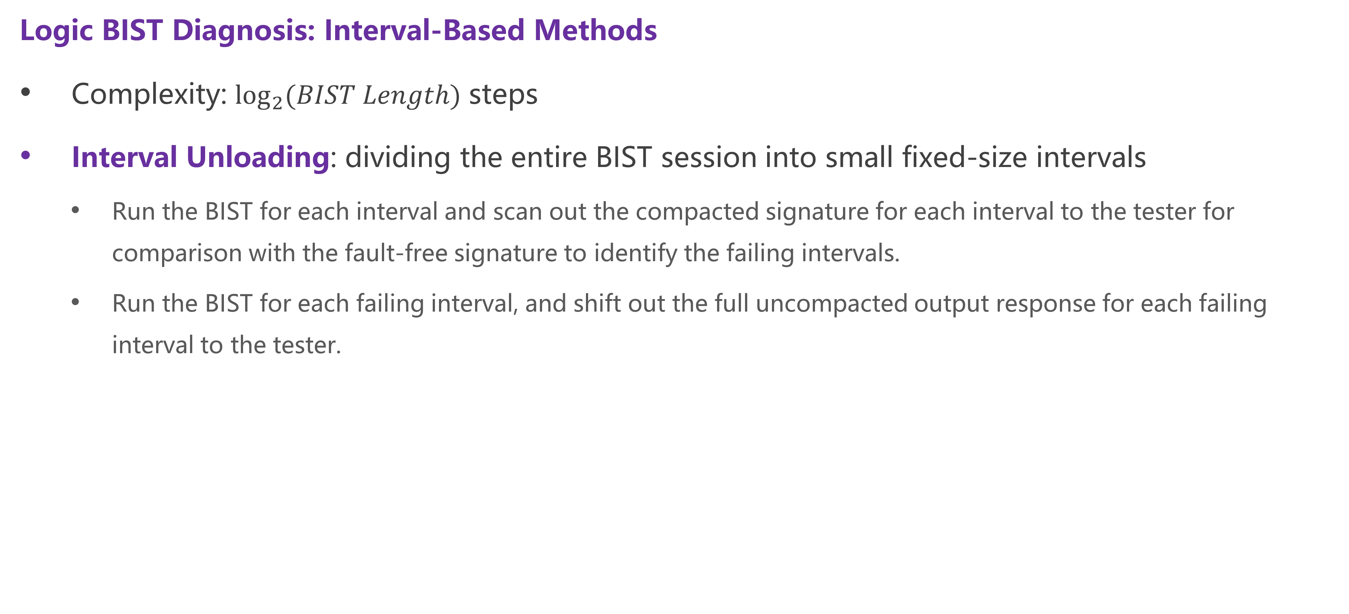
03 Logic BIST Diagnosis – Interval-Based Methods
Logic BIST Diagnosis: Interval-Based Methods
Complexity: $\log_{2}{(BIST Length)}$ steps
Interval Unloading: dividing the entire BIST session into small fixed-size intervals
Run the BIST for each interval and scan out the compacted signature for each interval to the tester for comparison with the fault-free signature to identify the failing intervals.
Run the BIST for each failing interval, and shift out the full uncompacted output response for each failing interval to the tester.

Slide 41
03 Logic BIST Diagnosis – Interval-Based Methods
Logic BIST Diagnosis: Interval-Based Methods
Interval Unloading v. s. Binary Search
Advantage: only two steps are required, thus being time-saving.
Drawback: more tester memory and more postprocessing is required.

Slide 42
03 Logic BIST Diagnosis – Masking-Based Methods
Logic BIST Diagnosis: Masking-Based Methods
Run the entire BIST session multiple times while masking out the output response for different sets of scan cells each time.
It is possible to obtain diagnostic information about which scan cells are capturing errors using only signatures; that is, it is not necessary to store and postprocess any uncompacted output responses.

Slide 43
03 Logic BIST Diagnosis – Masking-Based Methods
Logic BIST Diagnosis: Masking-Based Methods
A masking based method using pseudo-random masking to obtain space information very quickly:
Use a pseudo-random pattern generator (e. g. LFSR) which generates a selection signal during each BIST run.
The selection signal selects some scan cells whose output response is shifted into the signature analyser, while the output responses for the rest of the scan cells are masked out so they do not affect the final signature.
If the final signature for a BIST run is correct, then all scan cells whose output responses were included in the signature are considered to be fault free.
A nice feature of this method is that all information needed for diagnosis can be obtained in a single tester run provided the tester has sufficient memory to store the final signatures for all BIST runs.

Slide 44
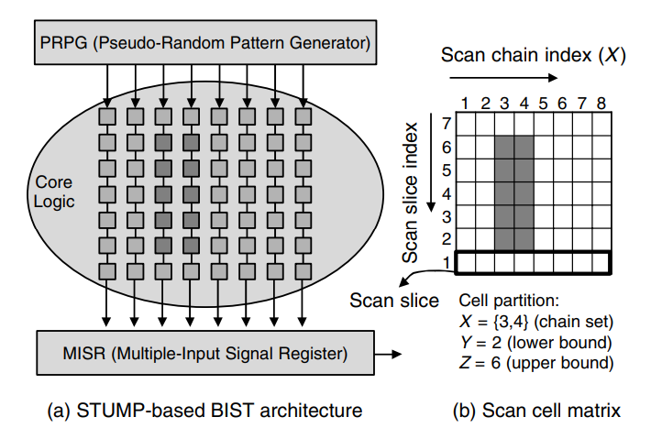
03 Logic BIST Diagnosis – Masking-Based Methods
Logic BIST Diagnosis: Masking-Based Methods
Deterministic masking:
The scan cells are selected in a deterministic manner using some scan cell partitioning logic that allows a binary search to be used. The scan cells can be represented as a matrix, where each column corresponds to a scan chain and each row corresponds to a scan slice.
The additional design-for-diagnosis (DFD) circuitry required for this method consists of the scan cell partitioning logic, which allows only the output response for the scan cells in the selected partition to be compacted in the MISR while the output responses for the rest of the scan cells are masked out.

Slide 45
Thanks for listening!
Haochen Ding

